Slide 1
Quality Attributes
Docker & Kubernetes

Slide 2
Related work
Since 2017-2018
The Present
NSWI150 - Virtualizace a cloud computing
NSWI177 - Úvod do Linuxu
NSWI153 - Pokročilé programování webových aplikací
…
Notes:
Fun fact the https://dictionary.cambridge.org/dictionary/english/present?q=Present define present with multiple meaning with English levels. Similar those subjects focus not only on different level but also area.

Slide 3
Quality Attributes
Run-Time
Availability (ANSI/TIA-942, …)
Performance
Security
…
Non-Run-Time
Modifiability
Portability
Testability
Reusability
Integrability
…
Notes:
Some attributes can be evaluated on multiple levels like availability. For example, I can run service on my computer for the internet. If I lost connection, it is issue with availability for the users, yet there is nothing bad with my code.

Slide 4
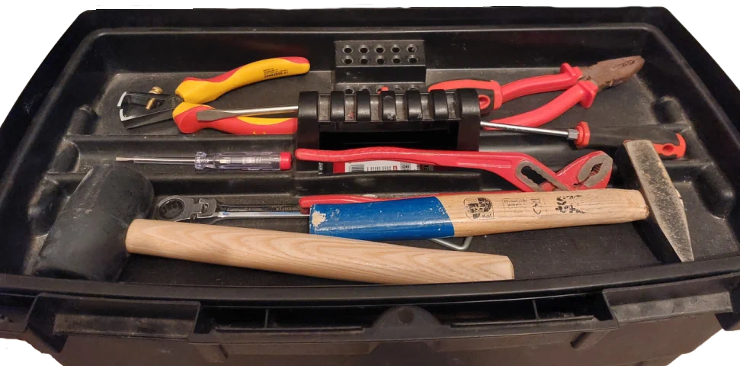
Toolbox – what is missing?
Notes:
Every task at hand may require specialized toolbox. The bigger and richer toolbox you have the more likely is that you have all the tools you need.

Slide 5
Managing expectations
I want to learn Docker / Kubernetes ...
print(“Hello, World!”)
C++ in 21 days
Software architect
A software architect is a software developer expert who makes high-level design choices
and tries to enforce technical standards, including software coding standards,
tools, and platforms.
Source https://en.wikipedia.org/wiki/Software_architect

Slide 6
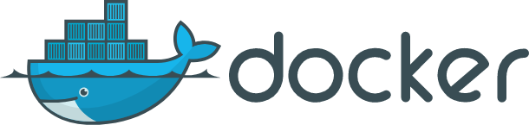
Docker

Slide 7
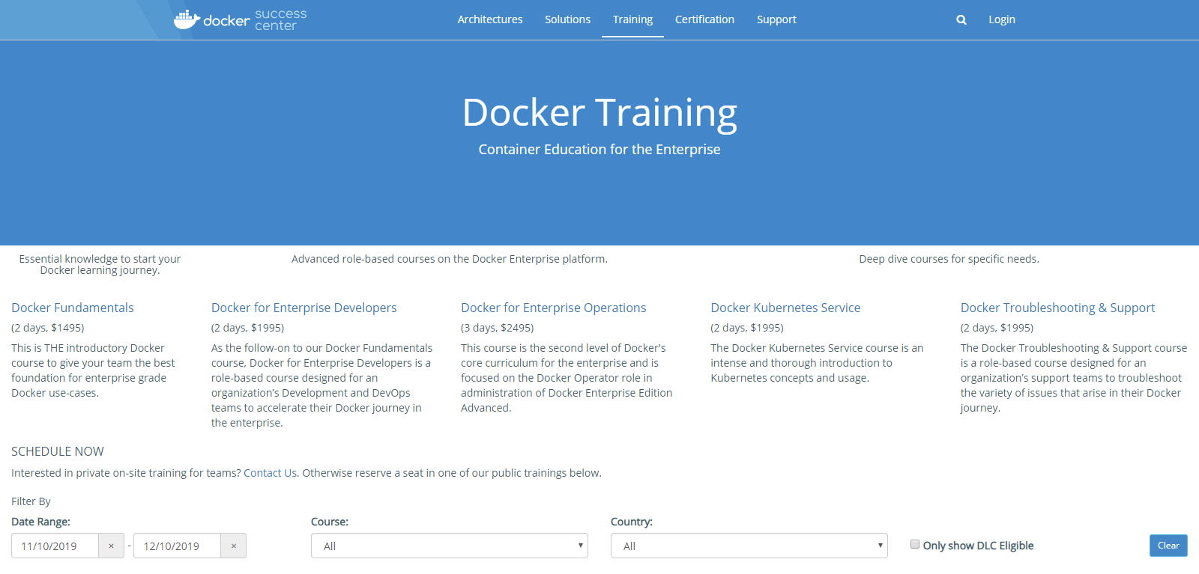
Learning Docker …
Notes:
It was this complex few years back, since then the ecosystem become more complicated, yet approachable.
Resource:
https://success.docker.com/training/

Slide 8
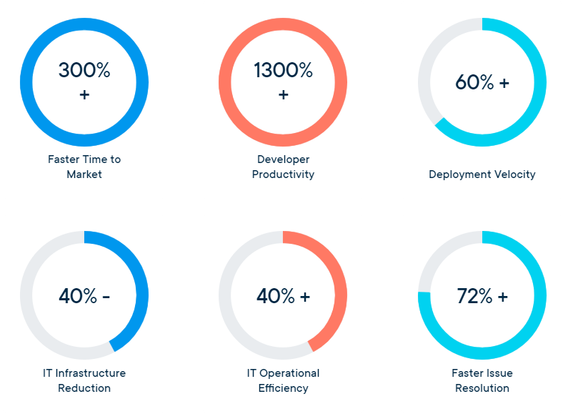
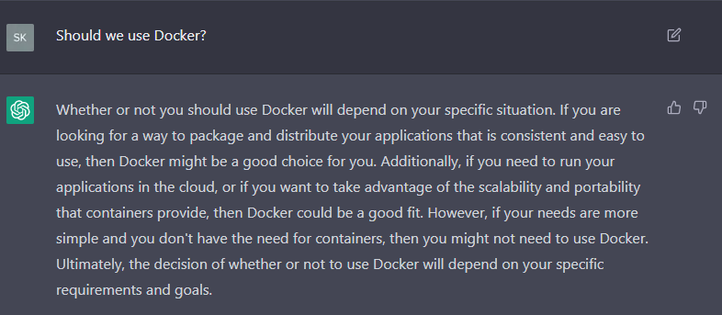
Why Docker ?
In 2013, Docker introduced what would become the industry standard for containers. Containers are a standardized unit of software that allows developers to isolate their app from its environment, solving the “it works on my machine” headache. For millions of developers today, Docker is the de facto standard to build and share containerized apps – from desktop, to the cloud.
Choose a plan that is right for you …
Notes:
Reasons have changed significantly, nowadays there is littler reason to talk about why Docker. Yet is good to see them, as there are always tools, technologies that promise you benefits. However, as the decision maker you must always see both sides of the coin.
Resources:
https://www.docker.com/why-docker
https://chat.openai.com/

Slide 9
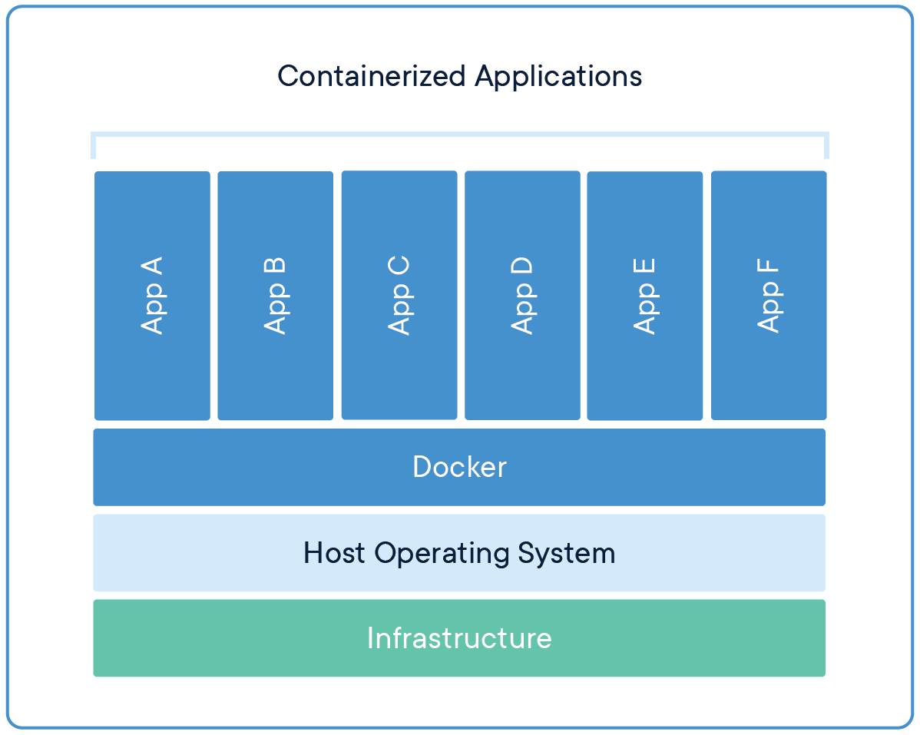
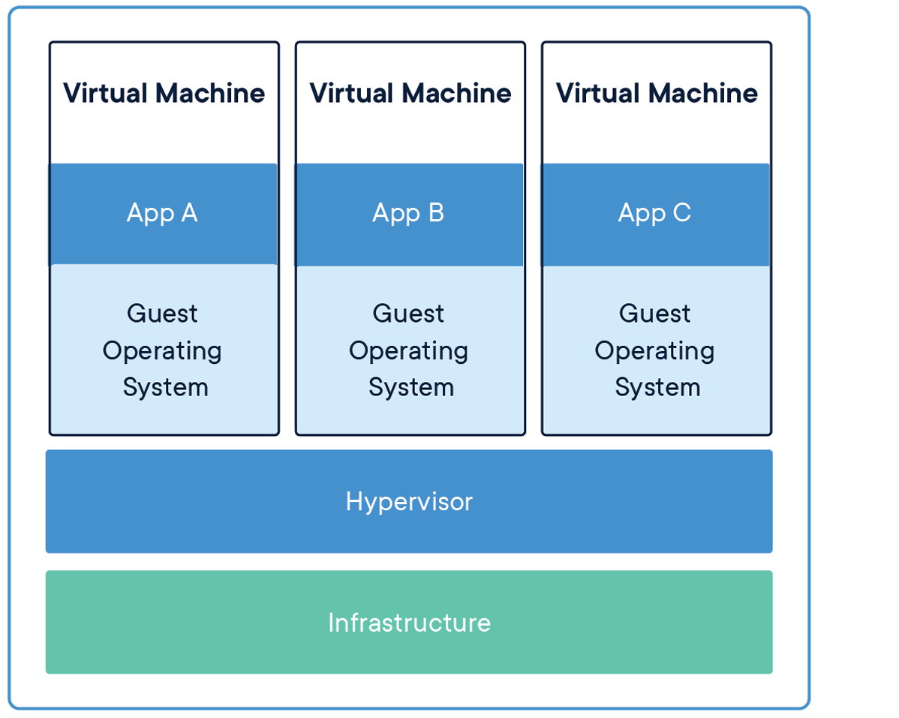
What are the selling points ?
Responsive deployment
Standardized environment
Lightweight and fast
Removed in 2022/2023
Notes:
Resource:
https://www.docker.com/resources/what-container

Slide 10

What is Docker?
Containerization is a lightweight virtualization technology
alternative to hypervisor virtualization.
Dockerfiles
Notes:
Introduce Image, Container and Dockerfile as a definition for an image. We need to maintain it.
Resources:
https://docs.docker.com/engine/docker-overview/#docker-engine

Slide 11

What is Docker?
Notes:
Not all is defined by the Dockerfile – only the image is. We can see that network and data volumes are outside the image.

Slide 12
Docker implementation
Linux namespaces provide isolated environments:
pid namespace - process isolation
net namespace - network interface
ip namespace - inter-process communication
mnt namespace - filesystem mounting points
uts namespace - isolation of kernel and version identifiers
Control groups (cgroups) to limit resources.
Union file system (UnionFS) variants to manage file system.
….
Notes:
Although there is strong isolation, it is not a sandbox. We need Linux kernel to run Docker.

Slide 13
Demo : Docker
Docker install
Docker commands
Hello world
Dockerfile
Node.js application

Slide 14
There is more ...
Docker Captain Program
Docker Volume
ADD / COPY / MAINTAINER / ENTRYPOINT/…
Multi-stage builds
Docker Network
API (REST, /var/run/docker.sock)
cAdvisor
Podman
….

Slide 15
Quality Attributes with Docker
Run-Time
Availability
Performance
Security
…
Non-Run-Time
Modifiability
Portability
Testability
Reusability
Integrability
…
Notes:
There can be more, like testability. Yet they are not really contribution of Docker. But rather by splitting the software into containers.

Slide 16
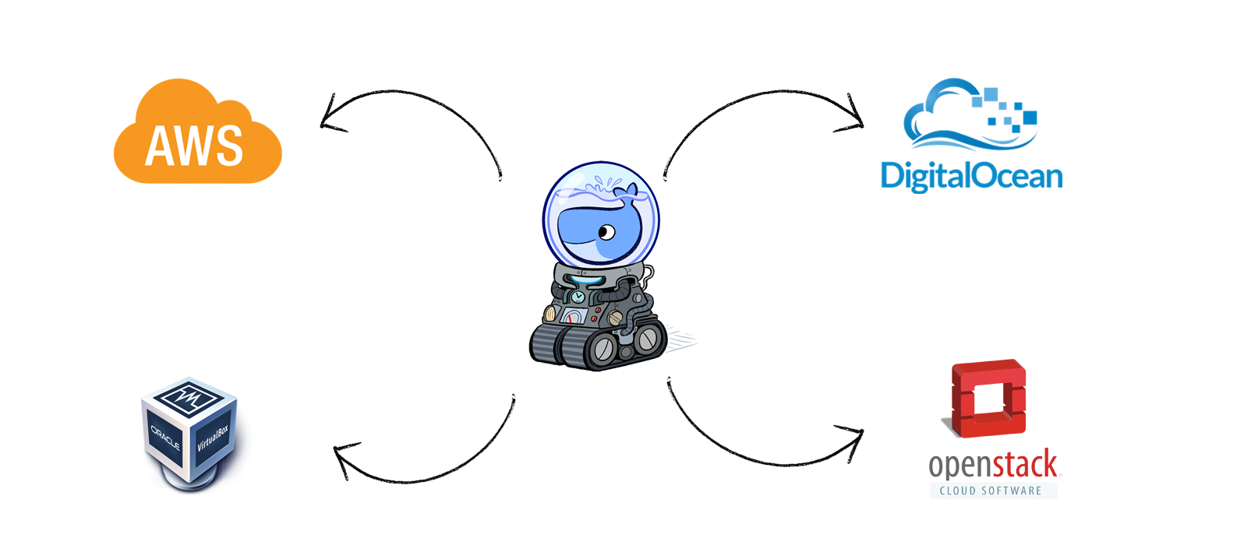
Docker Machine
Removed in 2022/2023
Notes:
How we can manage remote Docker instances, remember it is a client/server application.
Machine lets you create Docker hosts on your computer, on cloud providers, and inside your own data center. It creates servers, installs Docker on them, then configures the Docker client to talk to them.
Resource:
https://github.com/docker/machine

Slide 17
What if …
FROM maven:3-jdk-10-slim RUN apt-get update; apt-get upgrade –y RUN apt-get install -y curl software-properties-common gnupg; \ curl -sL https://deb.nodesource.com/setup_10.x | bash - RUN apt-get install -y nodejs RUN node -v; npm –v WORKDIR /etl COPY . . RUN mvn install –DskipTests RUN chmod a+x start.sh
CMD ["/bin/bash", "/etl/start.sh"]
exec ./executor.sh & exec ./executor-monitor.sh & exec ./storage.sh & exec ./frontend.sh
https://github.com/linkedpipes/etl/pull/627
Notes:
This is not how it should be done.
Resource:
https://github.com/linkedpipes/etl/pull/627

Slide 18
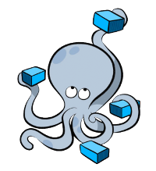
Docker Compose

Slide 19
Docker Compose
Docker Compose vs. Docker-Compose
Declarative
Definition in docker-compose.yml
Multiple isolated environments on a single host
Service discovery

Slide 20
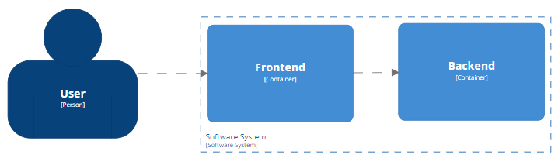
Demo : Docker Compose
Two services Frontend / Backend
Scale Frontend
Reverse proxy
Showcase Prankweb

Slide 21
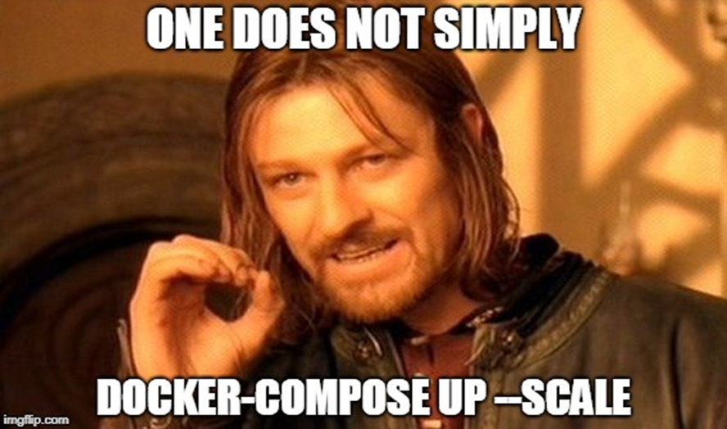
Meme Time
Notes:
There is no free lunch, your application muse be ready for it.

Slide 22
Quality Attributes with Docker Compose
Run-Time
Availability
Performance
Security
…
Non-Run-Time
Modifiability
Portability
Testability
Reusability
Integrability
…

Slide 23
There is more …
Multiple networks
Service dependencies
Development vs Production docker files
Docker Compose File
….

Slide 24
What is Container Orchestration?
Container orchestration is the automation of much of the operational effort required to run containerized workloads and services. This includes a wide range of things software teams need to manage a container's lifecycle, including provisioning, deployment, scaling (up and down), networking, load balancing and more.
… a containerized application might translate into operating hundreds or thousands of containers, especially when building and operating any large-scale system.
Source: https://www.vmware.com/topics/glossary/content/container-orchestration.html

Slide 25
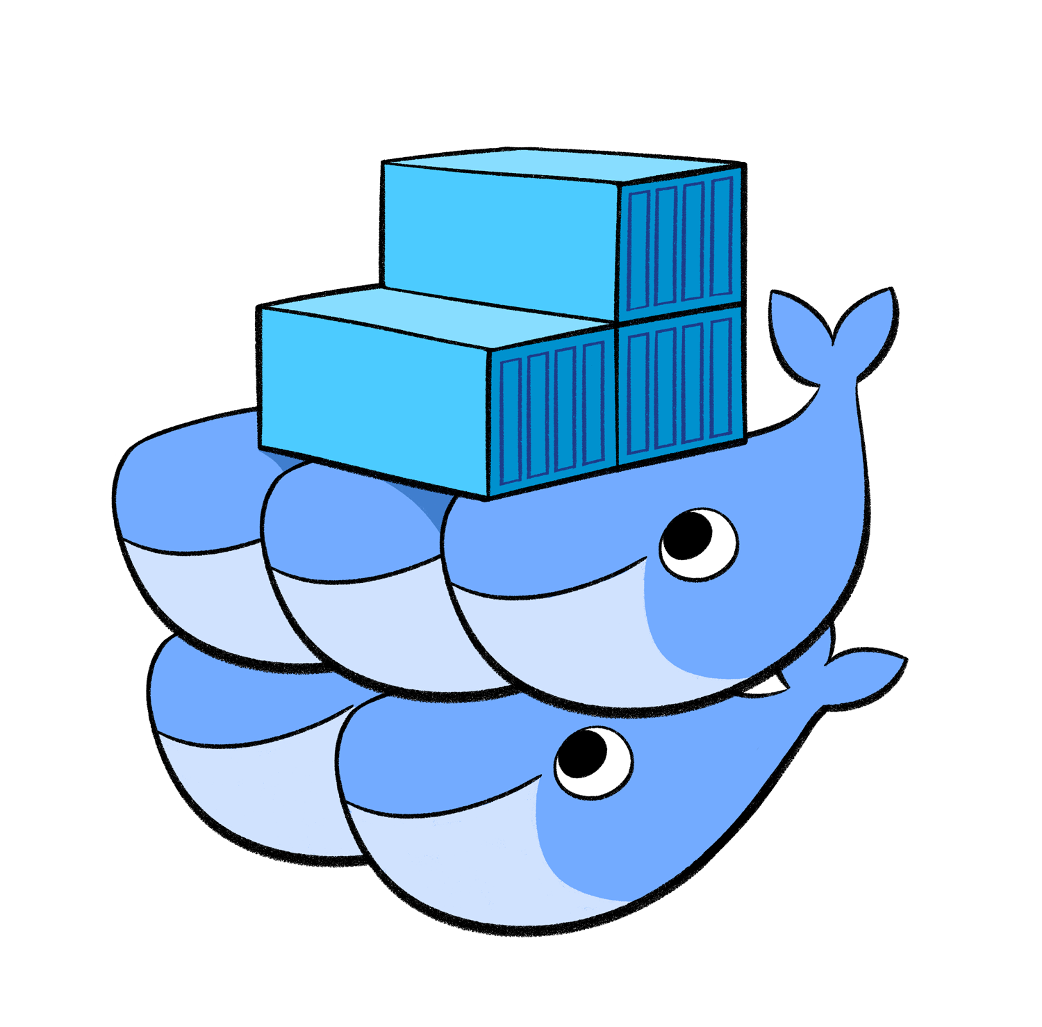
Docker Swarm

Slide 26
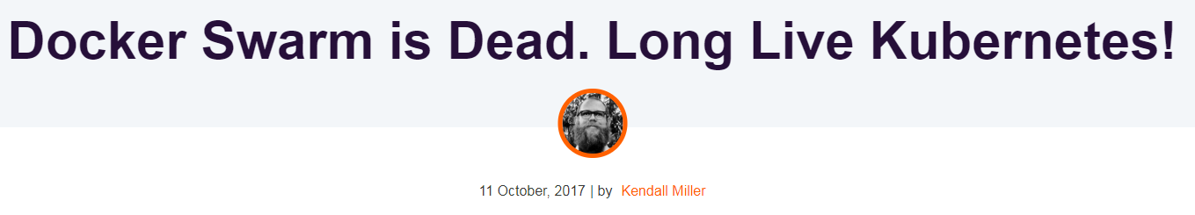
https://www.fairwinds.com/blog/docker-swarm-is-dead-long-live-kubernetes
Mirantis is committed to providing an excellent experience to all Docker Enterprise platform customers and currently expects to support Swarm for at least two years, depending on customer input into the roadmap. 11.2019
https://www.mirantis.com/blog/mirantis-acquires-docker-enterprise-platform-business/
The firm wanted to “to simplify container usage at enterprise scale with freedom of choice for orchestrators…and our customers can rest assured that Mirantis will continue to support their Swarm investments.” 02.2020
https://devclass.com/2020/02/25/mirantis-to-keep-docker-swarm-buzzing-around-pledges-new-features/
Classic Swarm has been archived and is no longer actively developed. You may want to use the Swarm mode built into the Docker Engine instead, or another orchestration system. 10.2022
https://github.com/docker-archive/classicswarmt
Notes:
Users of Docker Community Edition can safely continue to use Docker Swarm. Watch the official documentation for any notice of changes to Docker’s development plans. Users of Docker EE managed services should transition from Swarm to Kubernetes, because Swarm will not be supported in Docker EE in the future.
Resource:
https://www.aquasec.com/cloud-native-academy/docker-container/docker-orchestration/

Slide 27
Docker Swarm
A swarm is a group of (physical/virtual) machines (nodes) that are running Docker and joined into a cluster.
Orchestrate Docker containers which house stateless applications
Easy to deploy
Declarative service model / Desired state reconciliation
Service discovery
Secure by default
Rolling updates
Docker can be 'switched' into swarm mode
…
Source: https://docs.docker.com/engine/swarm/

Slide 28
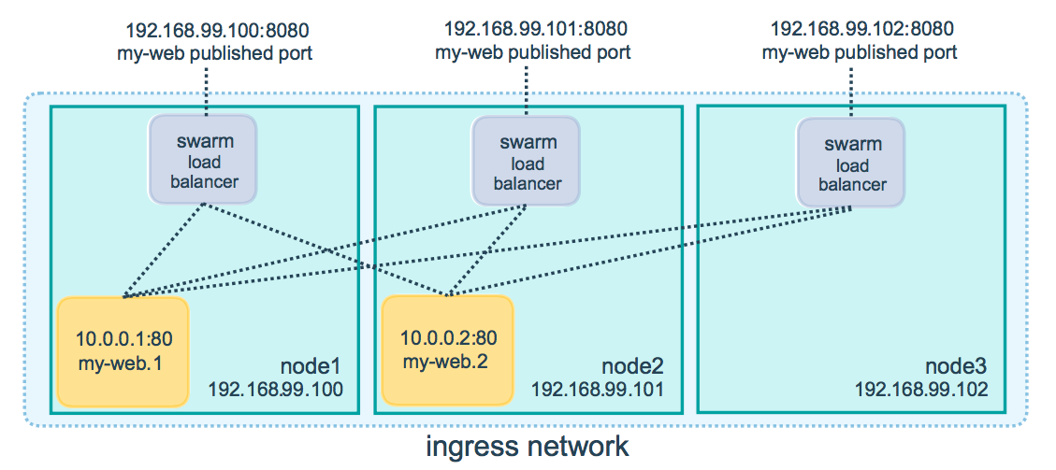
Docker Swarm
You can access the service by hitting any of the manager or worker nodes. It does not matter if the particular node does not have a container scheduled on it. That is the whole idea of the swarm.
Source: https://docs.docker.com/engine/swarm/ingress/
Notes:
Swarm is using internal load balancers and ingress network. The fact that we can hit any node is key idea here. Ideally you would put the Docker Swarm service behind a Load Balancer.

Slide 29
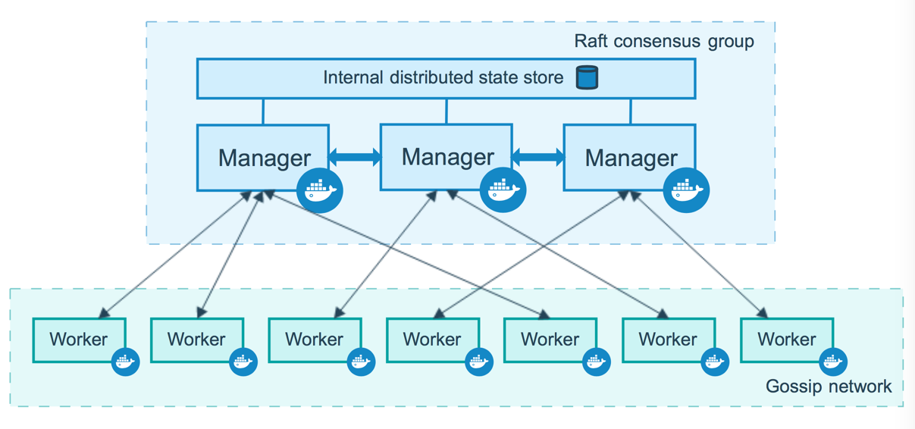
Docker Swarm Infrasctructure
Source: https://docs.docker.com/engine/swarm/how-swarm-mode-works/nodes/
Notes:
Manager nodes - maintaining cluster state, scheduling services, serving swarm mode HTTP API endpoints. To take advantage of swarm mode’s fault-tolerance features, Docker recommends you implement an odd number of nodes according to your organization’s high-availability requirements. Docker recommends a maximum of seven manager nodes for a swarm.
Worker nodes - also instances of Docker Engine whose sole purpose is to execute containers. You cannot have a worker node without at least one manager node.

Slide 30
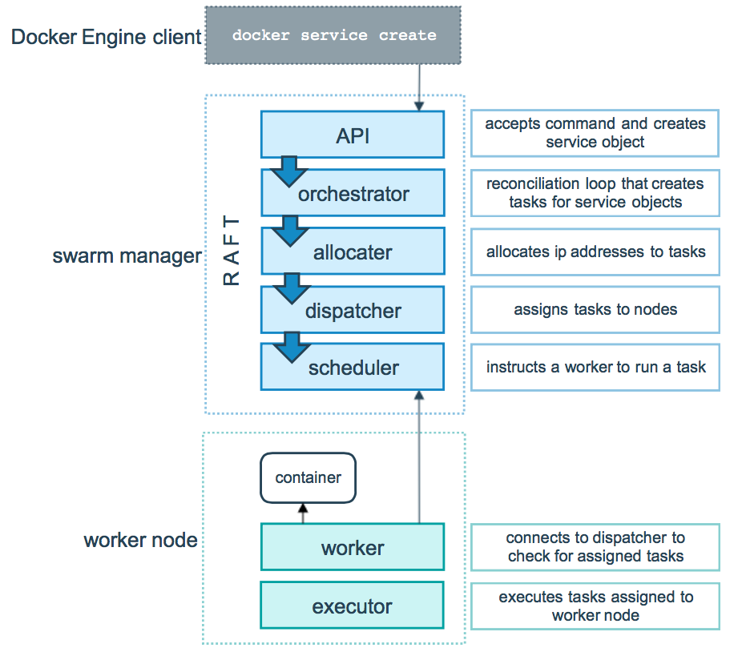
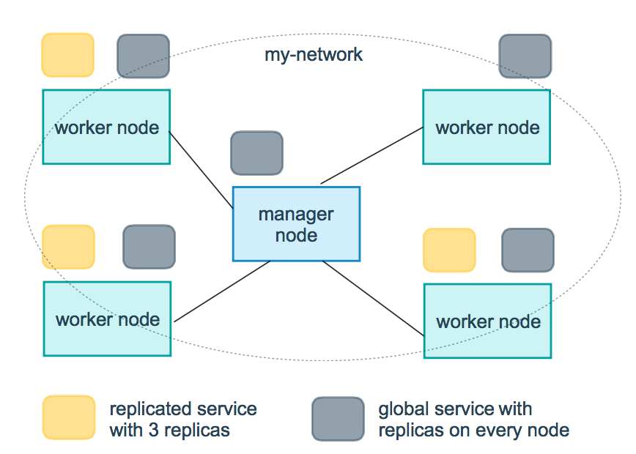
Docker Swarm Task
The underlying logic of Docker swarm mode is a general purpose scheduler and orchestrator. The service and task abstractions themselves are unaware of the containers they implement.
A task is a one-directional mechanism. It progresses monotonically through a series of states: assigned, prepared, running, etc. If the task fails the orchestrator removes the task and its container and then creates a new task to replace it according to the desired state specified by the service.
Source: https://docs.docker.com/engine/swarm/how-swarm-mode-works/services/
Notes:
Hypothetically, you could implement other types of tasks such as virtual machine tasks or non-containerized process tasks.
There are replicated and global services.

Slide 31
Demo : Docker Swarm
Create two Docker virtual machines
Create the Swarm
List nodes
Deploy Visualisation tool
Deploy application from Docker compose example
Cancelled
Notes:
It should work with Hyper-V, so demo may be back some dan in a future.
Resource:
https://www.virtualbox.org/ticket/20357

Slide 32
Docker Swarm
version: '3' services: frontend: image: skodapetr/tutorial-frontend ports: - 9030:8080 networks: - public - local backend: image: skodapetr/tutorial-backend networks: - local networks: public: local:
docker stack deploy -c services.yaml demo
docker service ls
…:9030/
?????
Notes:
We need external repository available from all nodes.

Slide 33
There is more … or is it?
Rolling updates
drain node (docker node update --availability drain worker)
Configuration data (echo "This is a config" | docker config create my-config -)
Secrets (printf "This is a secret" | docker secret create my_secret_data -)
Persistent Volume Service
Docker Swarm is Dead
….
Notes:
Drain node as a representative of infrastructure management command.
Configuration is available under /my-config by default, yet this is part of the configuration’s configuration. This is for non-sensitive data. Configs operate in a similar way to secrets, except that they are not encrypted at rest and are mounted directly into the container’s filesystem without the use of RAM disks.
Stateful applications need persistent storage, this can be handled using appropriate storage synchronized among all nodes. For example vsphere provide one, we can also use network storage.
Resource:
https://docs.docker.com/engine/swarm/configs/
https://blogs.vmware.com/virtualblocks/2017/04/10/orchestrate-stateful-containers-using-docker-swarm-vsphere-docker-volume-service/

Slide 34
Quality Attributes with Docker Swarm
Run-Time
Availability +
Performance +
Security
…
Non-Run-Time
Modifiability
Portability
Testability
Reusability
Integrability
…

Slide 35
What is Container Orchestration?
The million dollar question is, how do we build reliable and highly available systems from unreliable components?
The idea is to start with redundancy, detect component failure, and replace bad components quickly.
To achieve high availability, we must sacrifice consistency. But that doesn't mean that our system will have corrupt or arbitrary data. The keyword is eventual consistency.
Source: https://kubernetes.io/docs/tutorials/kubernetes-basics/scale/scale-interactive/

Slide 36
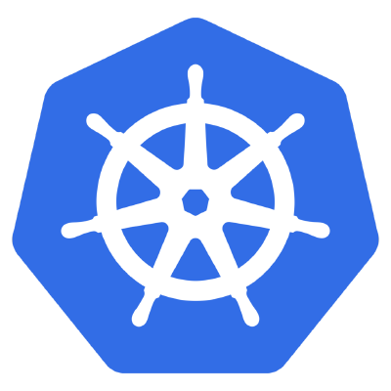
Kubernetes

Slide 37
Kubernetes
Kubernetes is an open-source system which allows you to run containers, manage them, automate deploys, scale deployments, create and configure ingresses, deploy stateless or stateful applications, and many other things.
… design to create a highly available applications.
Kubernetes Services and Swarm Services are very different! In Swarm, a service provides both scheduling and networking facilities, creating containers and providing tools for routing traffic to them. In Kubernetes, scheduling and networking are handled separately: deployments (or other controllers) handle the scheduling of containers as pods, while services are responsible only for adding networking features to those pods.

Slide 38
Kubernetes
Hackers Enlisted Tesla's Public Cloud to Mine Cryptocurrency
The attackers had apparently discovered that this particular Kubernetes console - an administrative portal for cloud application management—wasn't password protected and could therefore be accessed by anyone. From there they would have found … that one of the console's "pods," or storage containers, included login credentials for a broader Tesla Amazon Web Services cloud environment.
Source: https://www.wired.com/story/cryptojacking-tesla-amazon-cloud/
Kubernetes doesn't know what images are doing. It's difficult to protect the image preparation and delivery pipeline (including image repositories). Speed of development and deployment of new images conflict with careful review changes.
Source: https://arstechnica.com/information-technology/2018/06/backdoored-images-downloaded-5-million-times-finally-removed-from-docker-hub/
Notes:
Unlike Swarm, it is not secured by default. It is up to the user to define and enforce security policies. Kubernetes use namespaces as a way to create multi-user environment, yet, by default, nothing prevent one user to interact with all namespaces.

Slide 39
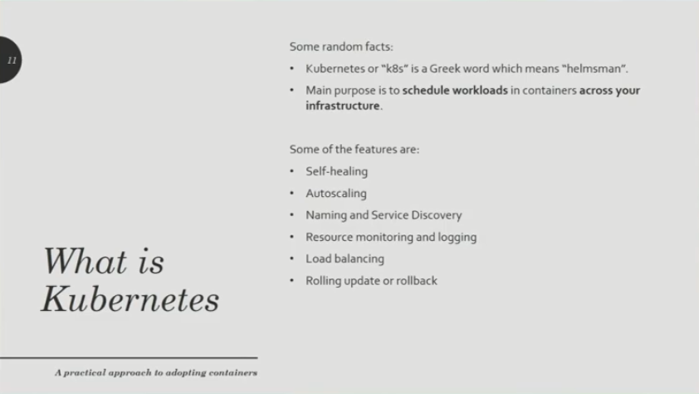

Kubernetes
Creates k8s clusters using voice.
Source: https://www.youtube.com/watch?v=LzEt5EYOguM https://twitter.com/kelseyhightower
Notes:
We can see Kubernetes as a service / API.
Video is no longer available online, and I think it is not from Kelsey, yet there is no way to verify that.
Yet there are other sources, like https://twitter.com/kelseyhightower , he can create cluster using only his voice! People are important, he is engineer in general not only about Kubernetes.
Resources:
https://www.linkedin.com/pulse/cloud-infrastructure-automation-pyramid-samir-shah/

Slide 40
Kubernetes as a Service
Abstract infrastructure
Declare desired state and send to API (kubectl) ~ contract
Easy to use difficult to master/manage/operate
Kubernetes makes assumptions on how your application behaves
Kubernetes operators (OperatorHub, Cassandra, …)
State primitives:
Service
An abstraction for pod identification
Pod
Group of containers deployed to a single node (computer)
Each have unique IP
Data are lost without a persistent storage
Deployment
Blueprint for pods
Can scale up replicas of pods
Volume
Request for storage
Notes:
Pods are designed to be short living - they should group related Docker images that should be on a single node. In Kubernetes 1.1, the official (tested and advertised) number was 30 pods per node. I actually ran 40 pods per node on Kubernetes 1.1, but I paid for it in excessive Kubelet overhead that stole CPU from the worker pods. In Kubernetes 1.2, the number jumped to 100 pods per node.
Operators are alternative to custom definitions. Good for third party software.
There are other primitives, we do not cover them here.

Slide 41
Demo : Kubernetes
LinkedPipes ETL
K8s deployment
kubectl apply –f ./k8s/
Online playground
Localhost minikube

Slide 42
Quality Attributes with Kubernetes
Run-Time
Availability ++
Performance ++
Security
…
Non-Run-Time
Modifiability
Portability
Testability
Reusability
Integrability
…

Slide 43
Kubernetes Super-Simplified
Operator
ETCD
Control Plane
Operator
Operator
Worker Node
Worker Node
Notes:
There is no good notation as this is not a good diagram, yet the notation serves the purpose. To show that this is just an approximation.

Slide 44
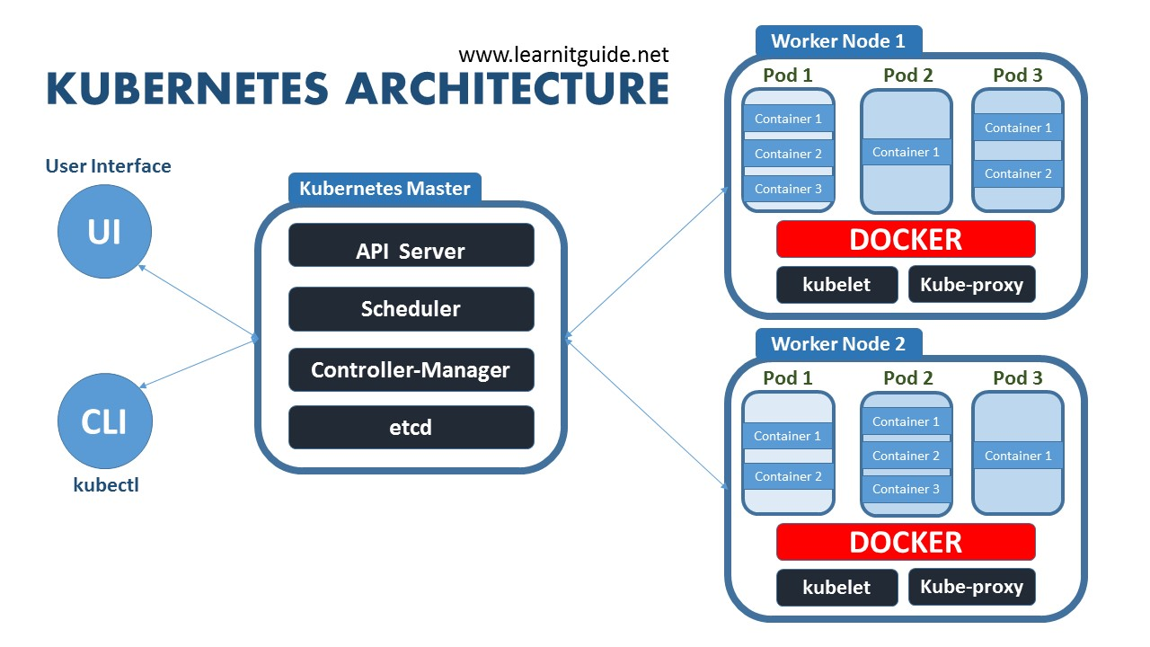
Kubernetes Simplified
Source: https://www.learnitguide.net/2018/08/what-is-kubernetes-learn-kubernetes.html
Notes:
The main unit of organization in Kubernetes is called a pod. A pod is a group of containers that are administered as a group on the same machine or virtual machine, a node, and are designed to be able to talk to one another easily.
API Server - Kube API Server interacts with API, Its a frontend of the kubernetes control plane.
Scheduler - Scheduler watches the pods and assigns the pods to run on specific hosts.
Kube-Controller-Manager - Controller manager runs the controllers in background which runs different tasks in Kubernetes cluster.
Node controller is responsible for noticing and responding when nodes go down.
Endpoint controllers joins services and pods together.
etcd is a simple distribute key value store. kubernetes uses etcd as its database to store all cluster datas.
Pods can be organized into a service, which is a group of pods that work together, and can be organized with a system of labels, which allow metadata about objects like pods to be stored in Kubernetes.
Kubelet is the primary node agent runs on each nodes and reads the container manifests which ensures that containers are running and healthy.
Kube-proxy is a process helps us to have network proxy and loadbalancer for the services in a single worker node. It performs network routing for tcp and udp packets, and performs connection folding. Worker nodes can be exposed to internet via kubeproxy.

Slide 45
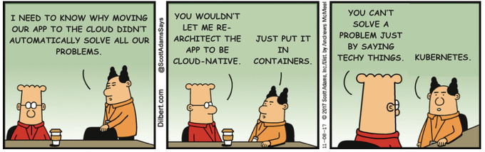
There is a lot more …
Highly customizable
It's like a Linux distribution …. OpenShift (Learn, Deploy a Spring application on OpenShift, MiniShift, K8sToOpenShift)
Package management: OperatorHub / Rancher / Helm / …
Rolling updates / Canary deployments / …
Auto scaling
Federates clusters
Secrets / Jobs / ….
OpenFaaS
….
Notes:
OpenShift - OpenShift is a platform as a service (PaaS) from Red Hat that is built on Docker and Kubernetes. The first new concept OpenShift adds is project, which effectively wraps a namespace, with access to the namespace being controlled via the project. Access is controlled through an authentication and authorization model based on users and groups. Projects in OpenShift therefore provide the walls between namespaces, ensuring that users, or applications, can only see and access what they are allowed to.
OperatorHub – list of operators, ways to deploy to Kubernetes. Operator allow easy deployment, and often provides additional features.
Rancher – Using Charts, Rancher provide way to easily deploy an application. Works as manager and as a gateway to other solutions (software). It is about how you create the chart (operator) and manage them.
Helm – is another package manager for k8s.
OpenFass – Running serverless functions on Docker and Kubernetes. This allows for better resource utilization. Especially when we have Kubernetes as a service.
Resources:
https://twitter.com/robotterror/status/1178874201236656128 - building production ready k8s takes 6 months in 2019

Slide 46
Resources
Portainer
Graphical user interface for management. Stacks – is docker-compose, extended with visual UI. Has building registry of applications.
Istio
Istio runs in a Linux container in your Kubernetes pods (much like a sidecar rides alongside a motorcycle) and injects and extracts functionality and information based on your configuration.
https://opensource.com/article/18/9/what-istio
https://github.com/redhat-developer-demos/istio-tutorial

Slide 47

I can only …
Notes:
I can only show you the door .. you’re the one that has to walk through it.

